Slide 1
PC Maintenance and Repair
Chapter 1 Test Review

Slide 2
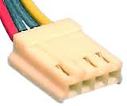

Slide 3
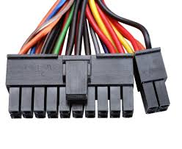

Slide 4
What is the benefit of 20 + 4 pin P1 power connectors?

Slide 5
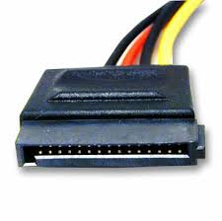

Slide 6
What unit of measurement is typically used for: RAM? Hard Drives?

Slide 7
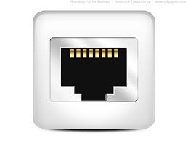

Slide 8
What number system is shown below? 10010010

Slide 9
What device is helpful in the event of a power outage?

Slide 11
If your computer components are not broken, yet your computer doesn’t start up, what is likely the problem?

Slide 12
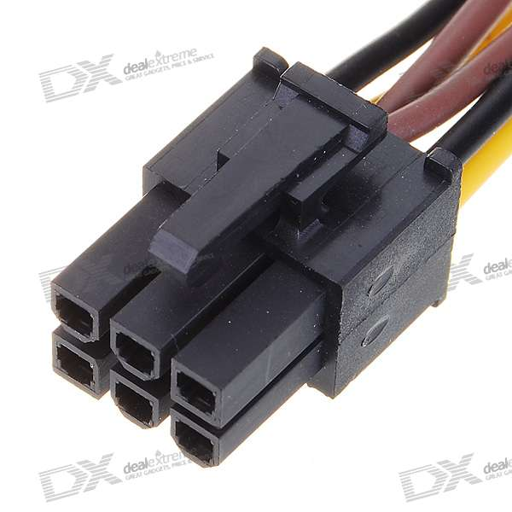

Slide 13
The transfer of data from RAM to a hard drive is called _______?

Slide 15
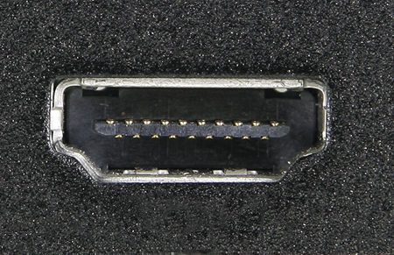

Slide 16
PS/2 ports are older ports and are color purple and green. What peripheral device is connected to each color?

Slide 19
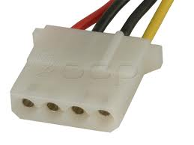

Slide 20
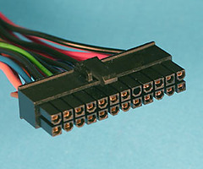

Slide 21
What are benefits of a tower case vs. desktop case?

Slide 22
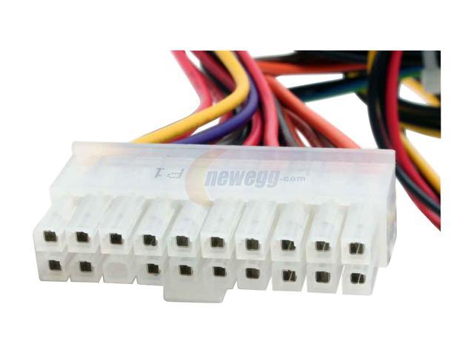

Slide 23
What do we call software that is built into the motherboard or hardware?

Slide 24
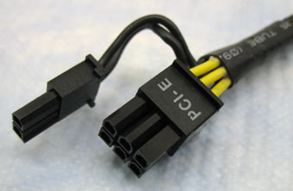

Slide 25
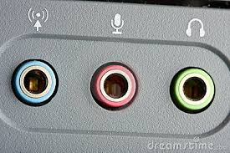

Slide 26
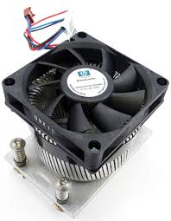

Slide 27
How many pins in a floppy data cable?

Slide 28
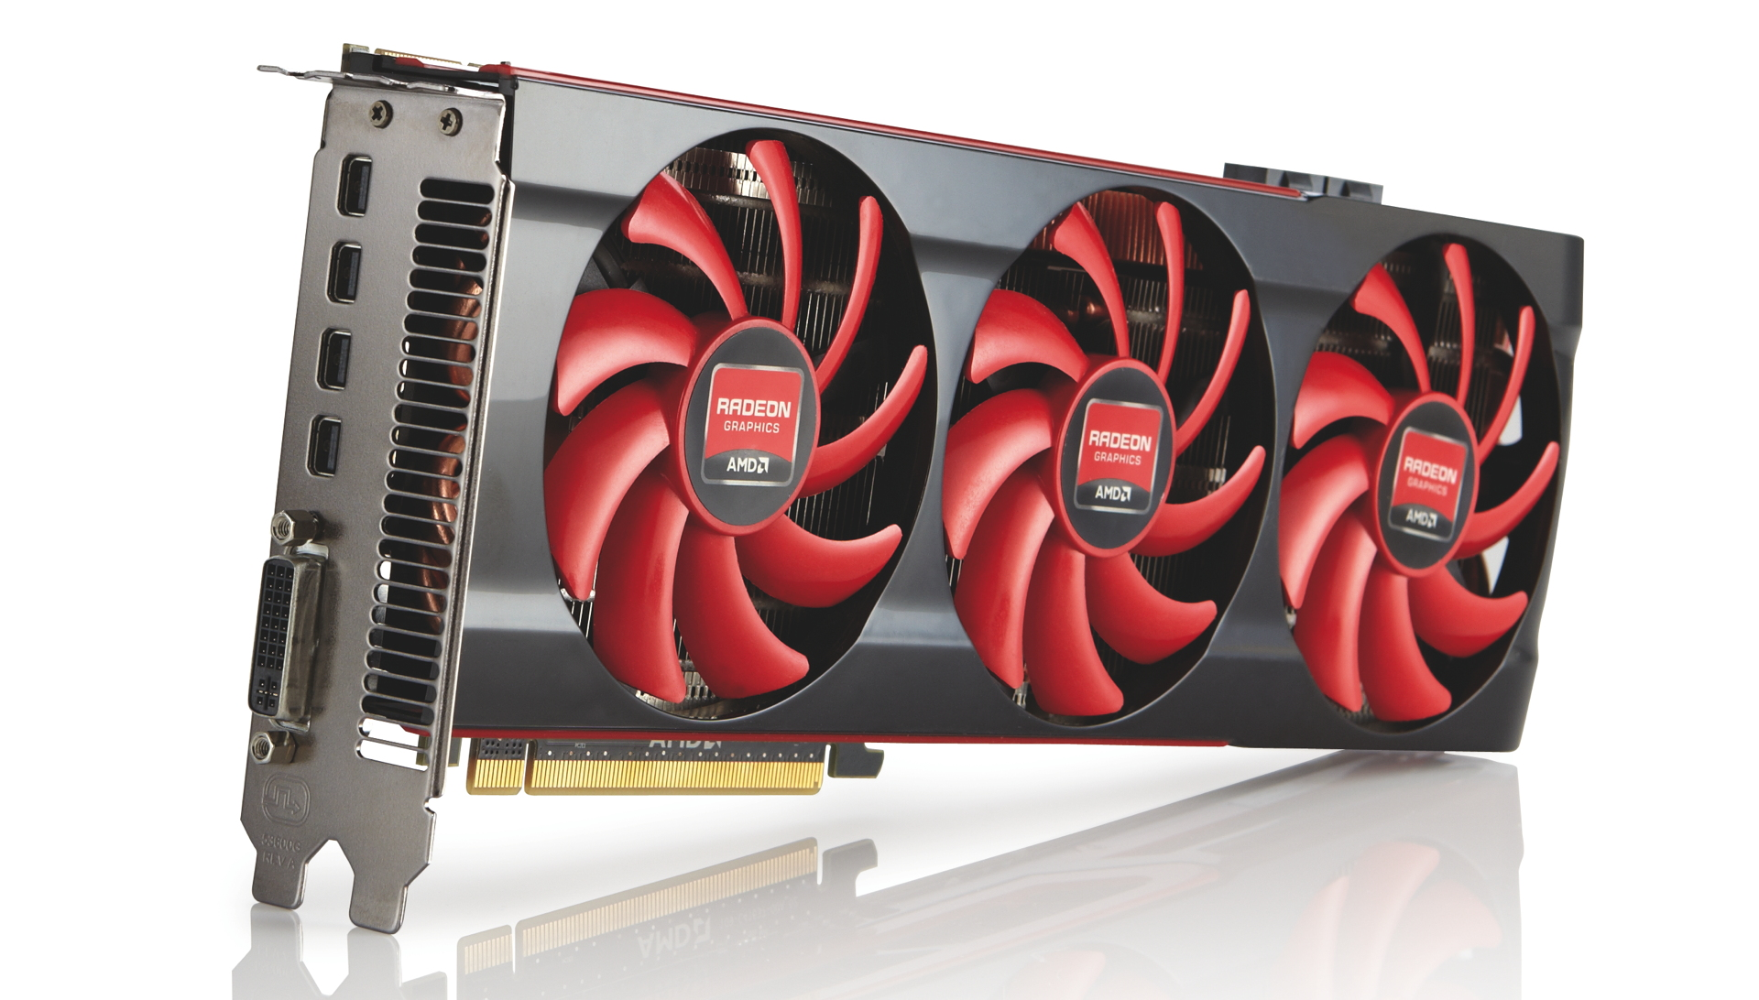

Slide 29
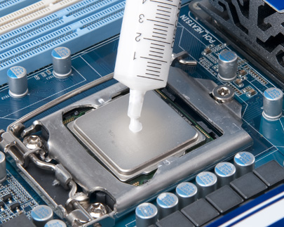

Slide 30
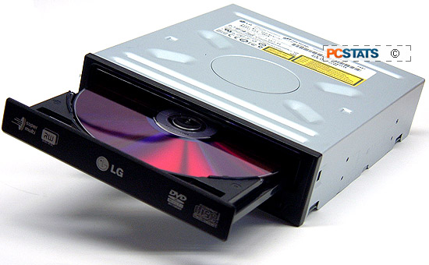

Slide 31
What are the two types of motherboards?

Slide 32
ATX and MicroATX

Slide 33
What device is typically connected to a parallel port?

Slide 34
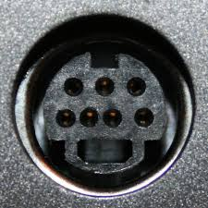

Slide 36
What is another name for ESD?

Slide 37
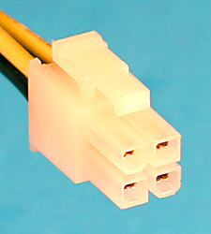

Slide 38
Power supply connectors with 20 or 24 pins are used to supply power to what computer component?

Slide 39
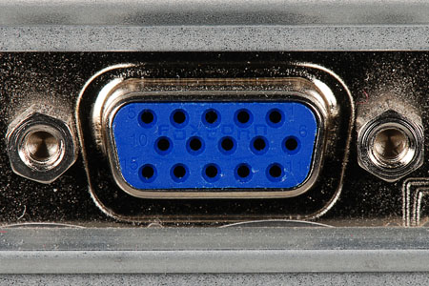

Slide 40
Name two devices that can be connected to the motherboard with an IDE cable?

Slide 41
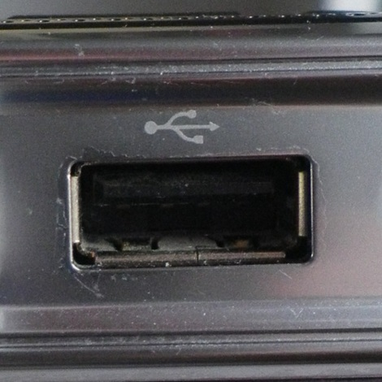

Slide 42
What devices are powered with a 4-Pin Molex connector?

Slide 43
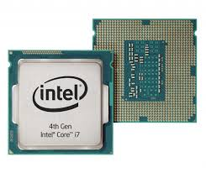

Slide 44
Name two computer components that help keep the CPU cool?

Slide 45
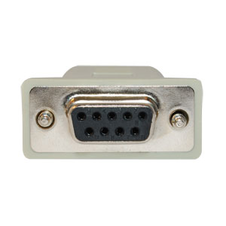

Slide 46
What computer component does a power connector with 4 pins provide power to?

Slide 47
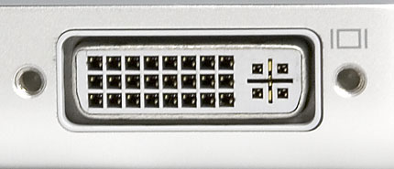

Slide 48
True or False SATA data cables and power connectors are used to connect to newer optical and hard drives

Slide 49
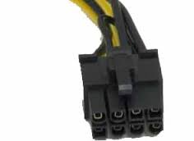

Slide 50
What common port replaced serial ports?

Slide 51
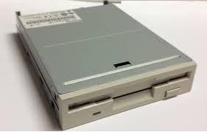

Slide 52
What kind of device is usually connected to a computer via a FireWire port?

Slide 53
How many bits in a byte?

Slide 54
What kind of signal do computers understand? (analog or digital)

Slide 55
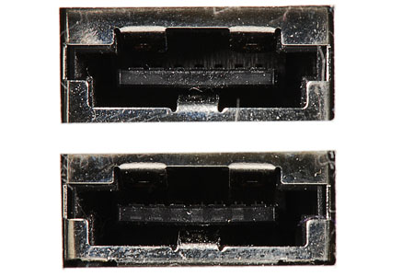

Slide 56
What term is used for the amount of data a CPU can process, send or receive at a time?

Slide 57
Provide two other names for RAM.

